Slide 1
Green’s Function
Sea Level Change – Spring 2021

Slide 2
Learning Objectives
Understand
what a delta function / impulse response is
how convolution works
what Green’s functions are

Slide 3
Learning Objectives
Apply
Greens Function concept to Ice loading

Slide 4
Learning Objectives
Connect
Laplace transform to Fourier transform
Greens Functions to Sea Level Change

Slide 5
Learning Objectives
Understand
what a delta function / impulse response is
how convolution works
what Green’s functions are
Apply
GF concept to Ice loading
Connect
Laplace transform to Fourier transform
GF to sea level

Slide 6
Overview
A Green’s function is the impulse response to a differential equation
It may be used to calculate the solution of a differential equation for any forcing function
This is achieved by the convolution of the Green’s function with the forcing function in one domain or by point-wise multiplication of the functions in the other domain

Slide 7
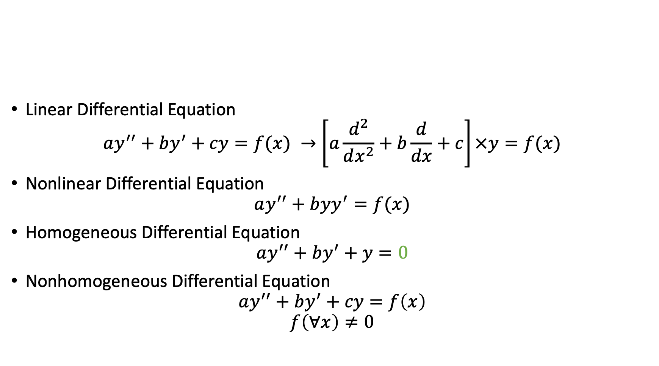
Review of Differential Equations
Linear Differential Equation
$$ay^{′′}+by^{′}+cy=f(x) →\left[\left.a\frac{d^{2}}{dx^{2}}+b\frac{d}{dx}+c\right]\right.×y=f(x)$$
Nonlinear Differential Equation
$$ay^{′′}+byy^{′}=f(x)$$
Homogeneous Differential Equation
$$ay^{′′}+by^{′}+y=0$$
Nonhomogeneous Differential Equation
$$ay^{′′}+by^{′}+cy=f\left(x\right)$$
$$f\left(∀x\right)≠0$$

Slide 8
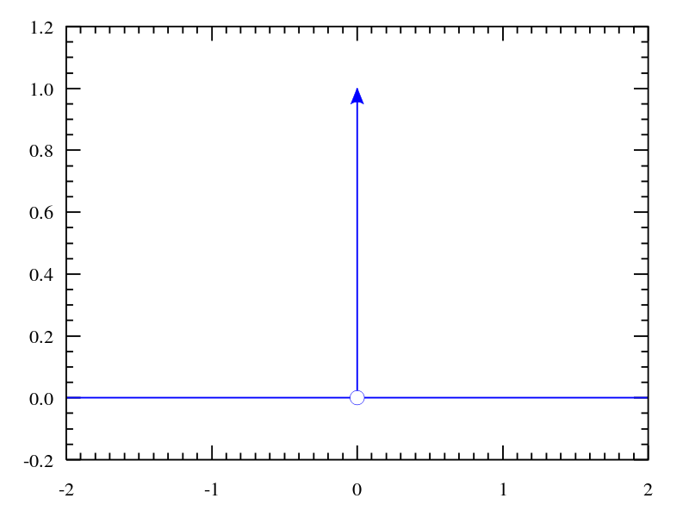
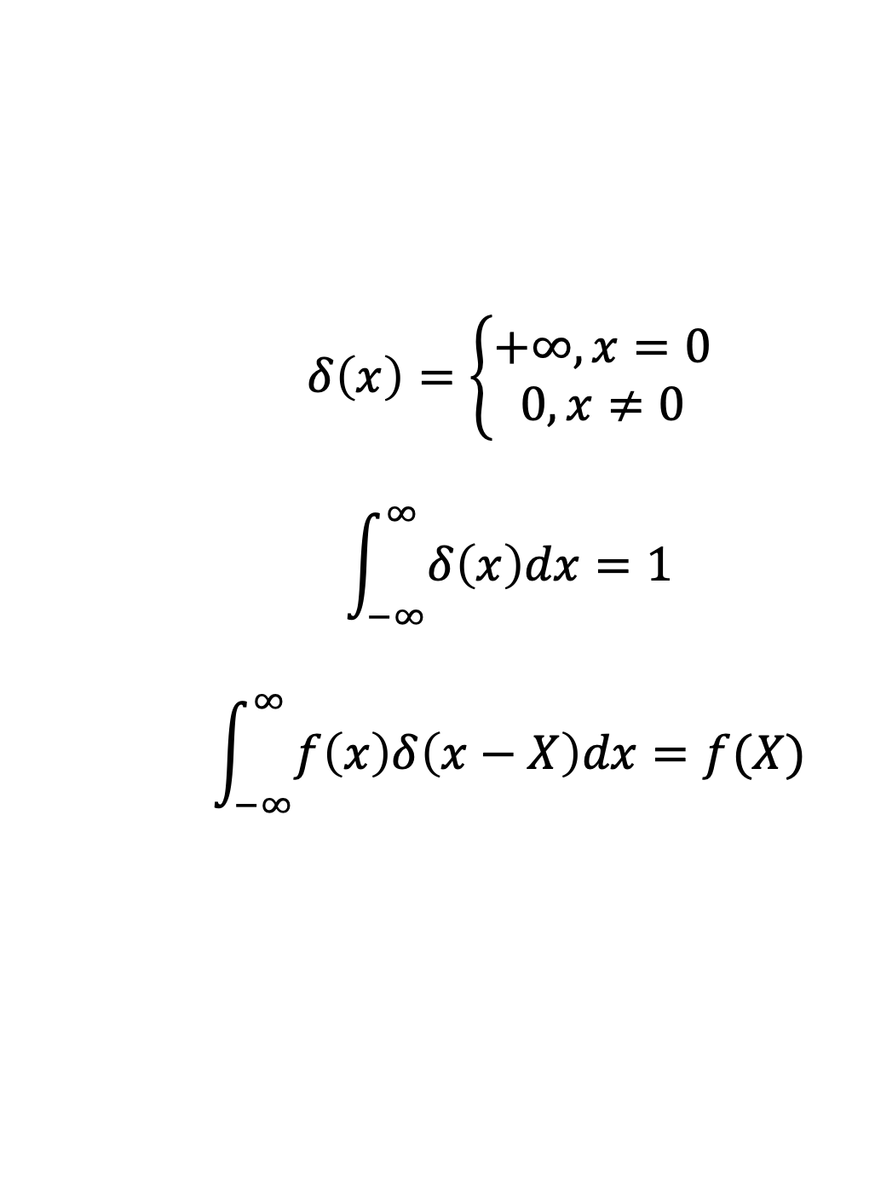
Impulse function
Dirac Delta Function (Continuous)
$$δ\left(x\right)=\left\{\begin{aligned}+∞, x=0 \\ 0, x≠0\end{aligned}\right.$$
$$\int_{−∞}^{∞}{δ\left(x\right)dx}=1$$
$$\int_{−∞}^{∞}{f\left(x\right)δ\left(x−X\right)dx=f(X)}$$

Slide 9
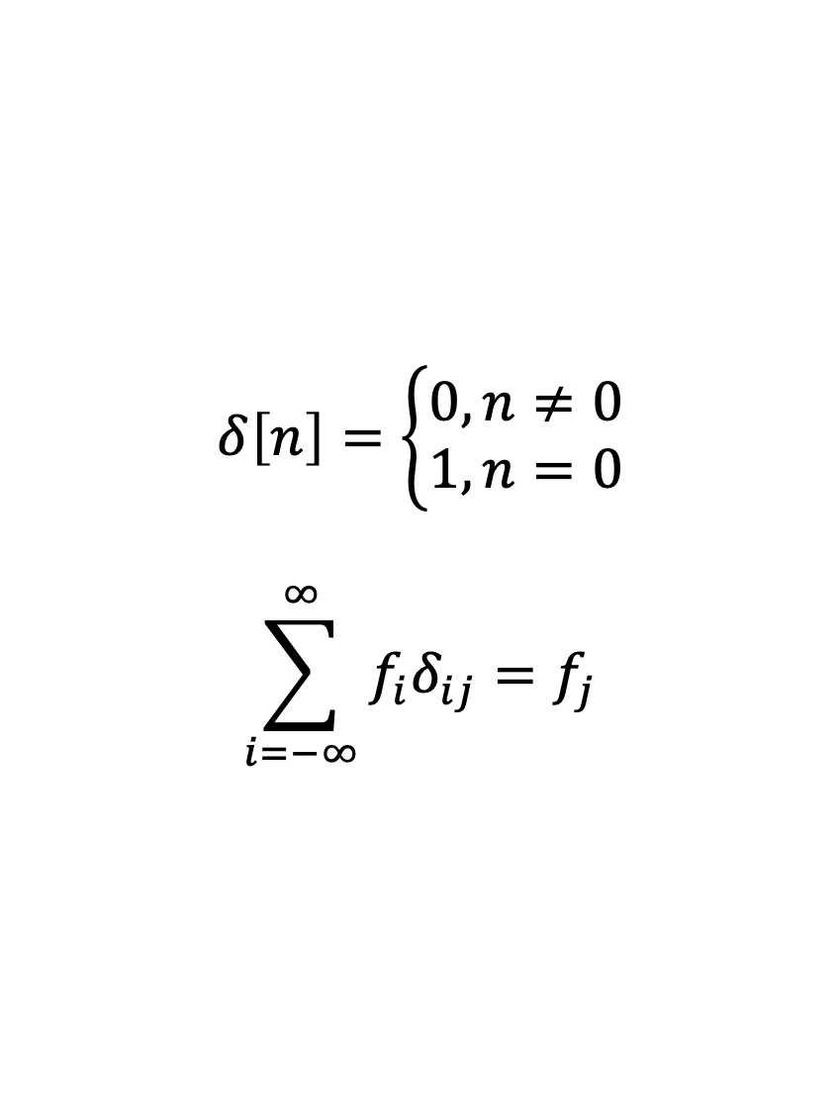
Impulse function
Kronecker Delta Function (Discrete)
$$δ\left[n\right]=\left\{\begin{aligned}0,n≠0 \\ 1,n=0\end{aligned}\right.$$
$$\sum_{i=−∞}^{∞}{f_{i}δ_{ij}=f_{j}}$$

Slide 10
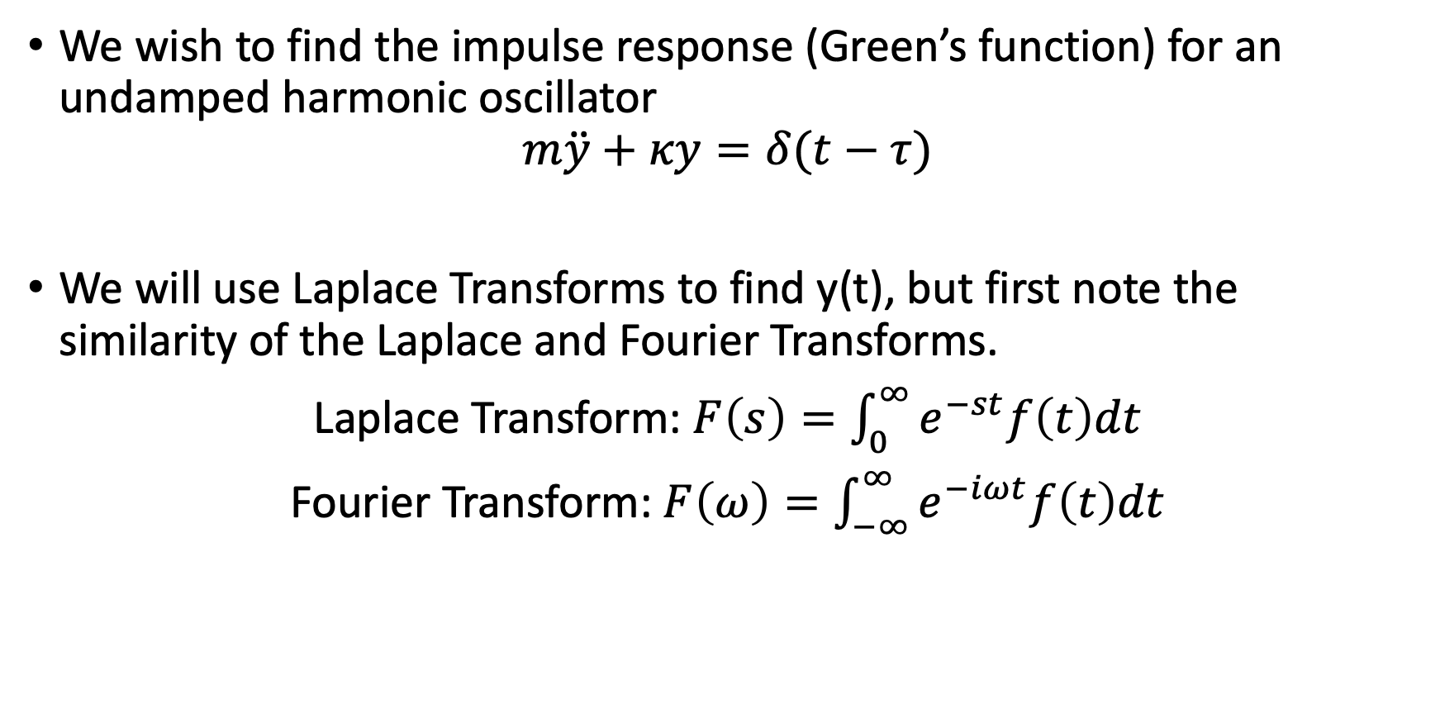
Example – Undamped Harmonic Oscillator
We wish to find the impulse response (Green’s function) for an undamped harmonic oscillator
$$m\ddot{y}+κy=δ(t−τ)$$
We will use Laplace Transforms to find y(t), but first note the similarity of the Laplace and Fourier Transforms.
Laplace Transform: $F\left(s\right)=\int_{0}^{∞}{e^{−st}f\left(t\right)dt}$
Fourier Transform: $F\left(ω\right)=\int_{−∞}^{∞}{e^{−iωt}f\left(t\right)dt}$

Slide 11
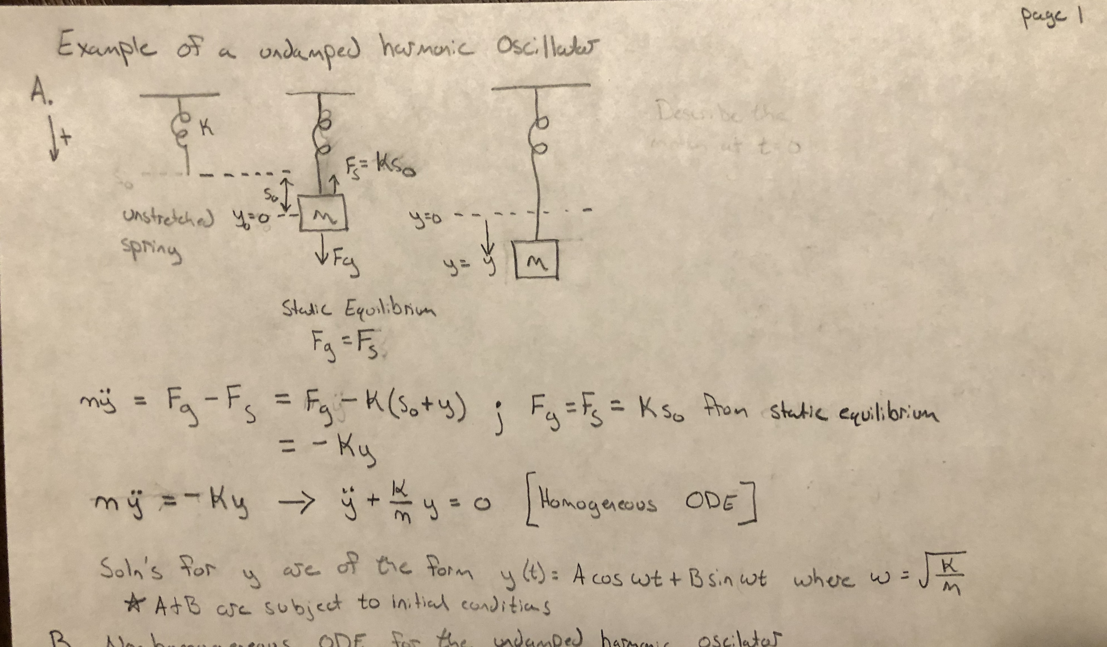

Slide 12
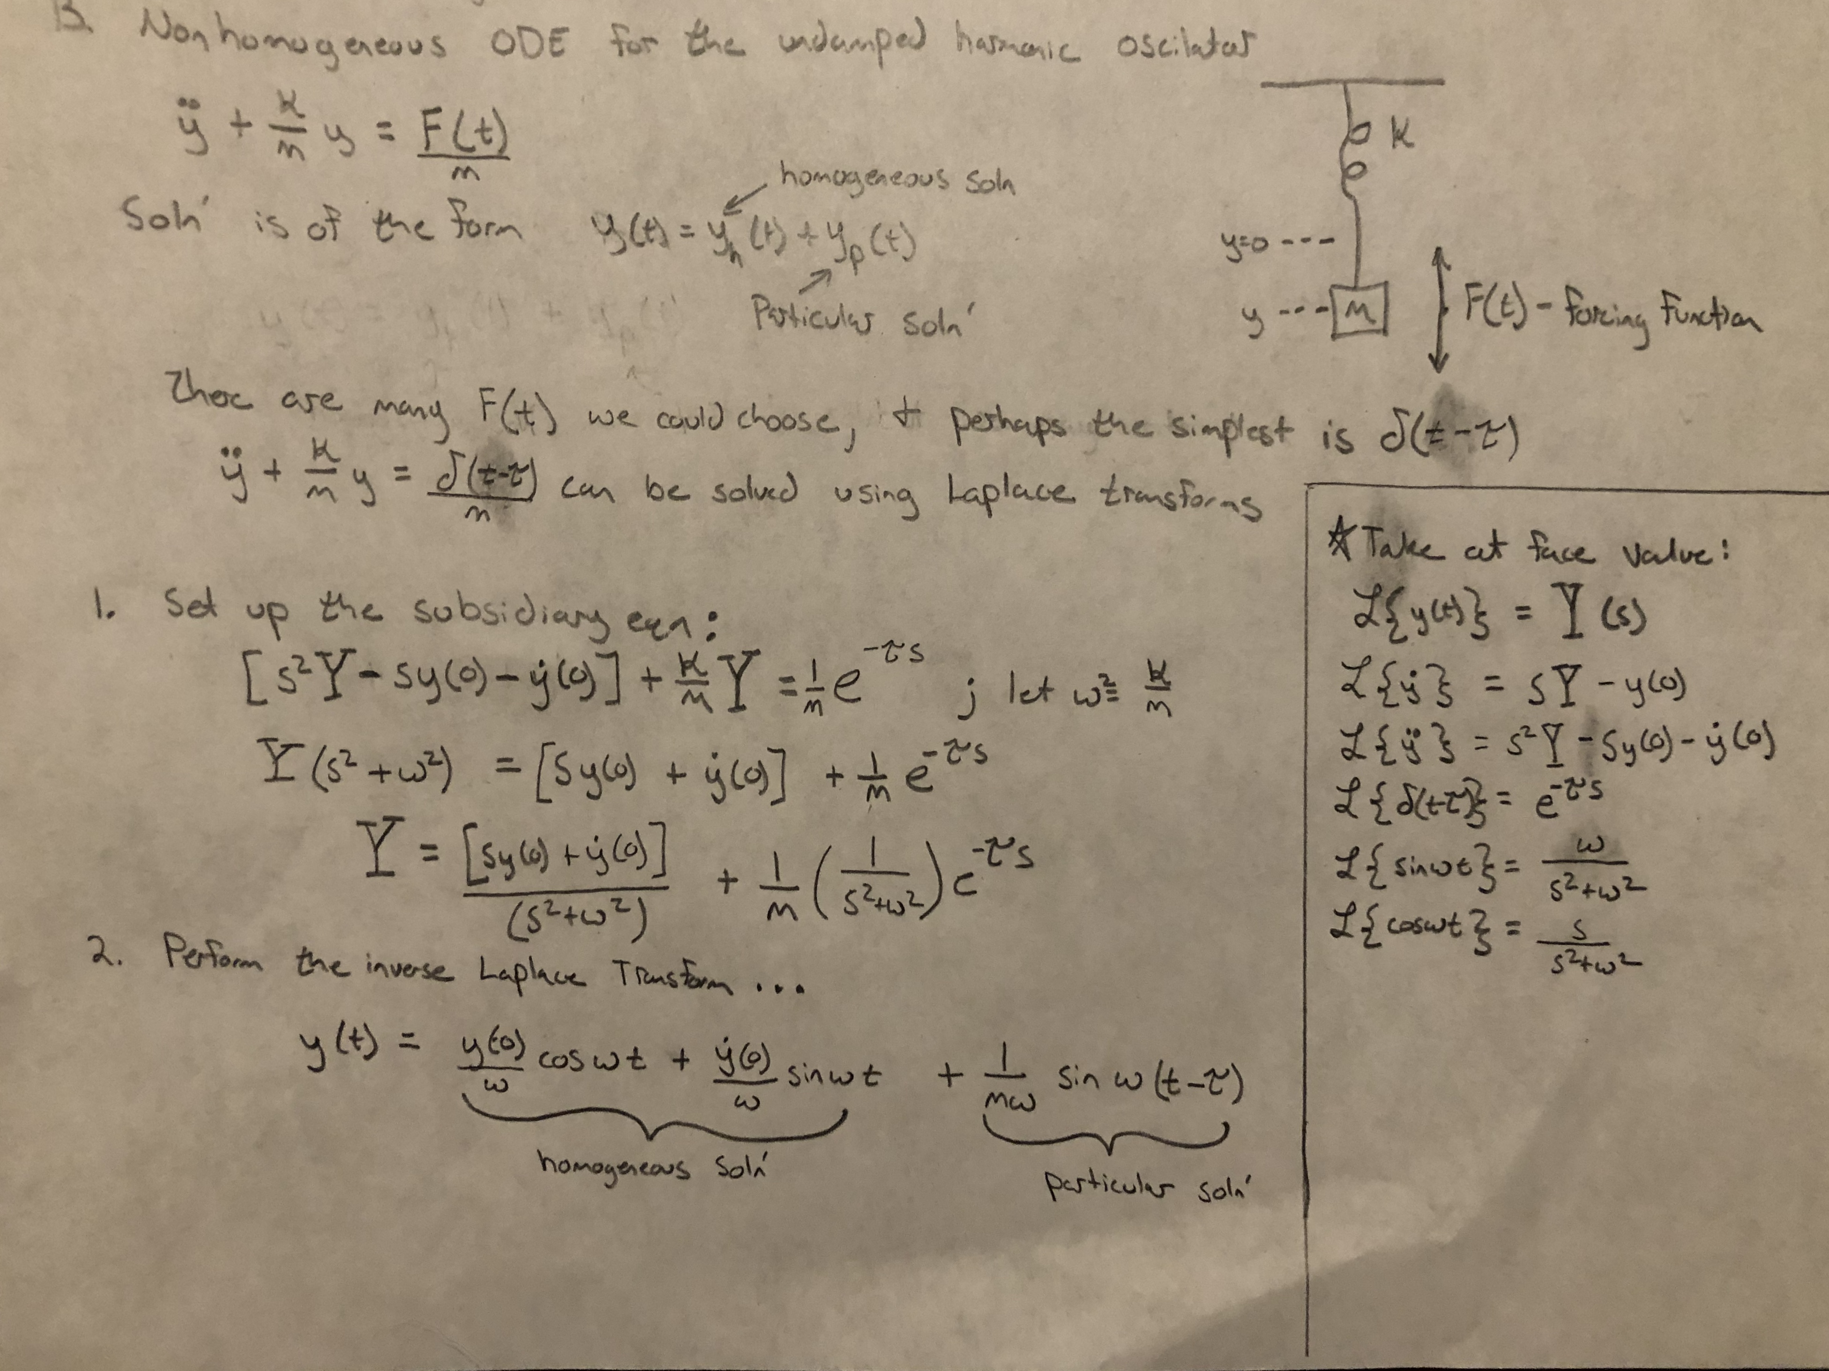

Slide 13
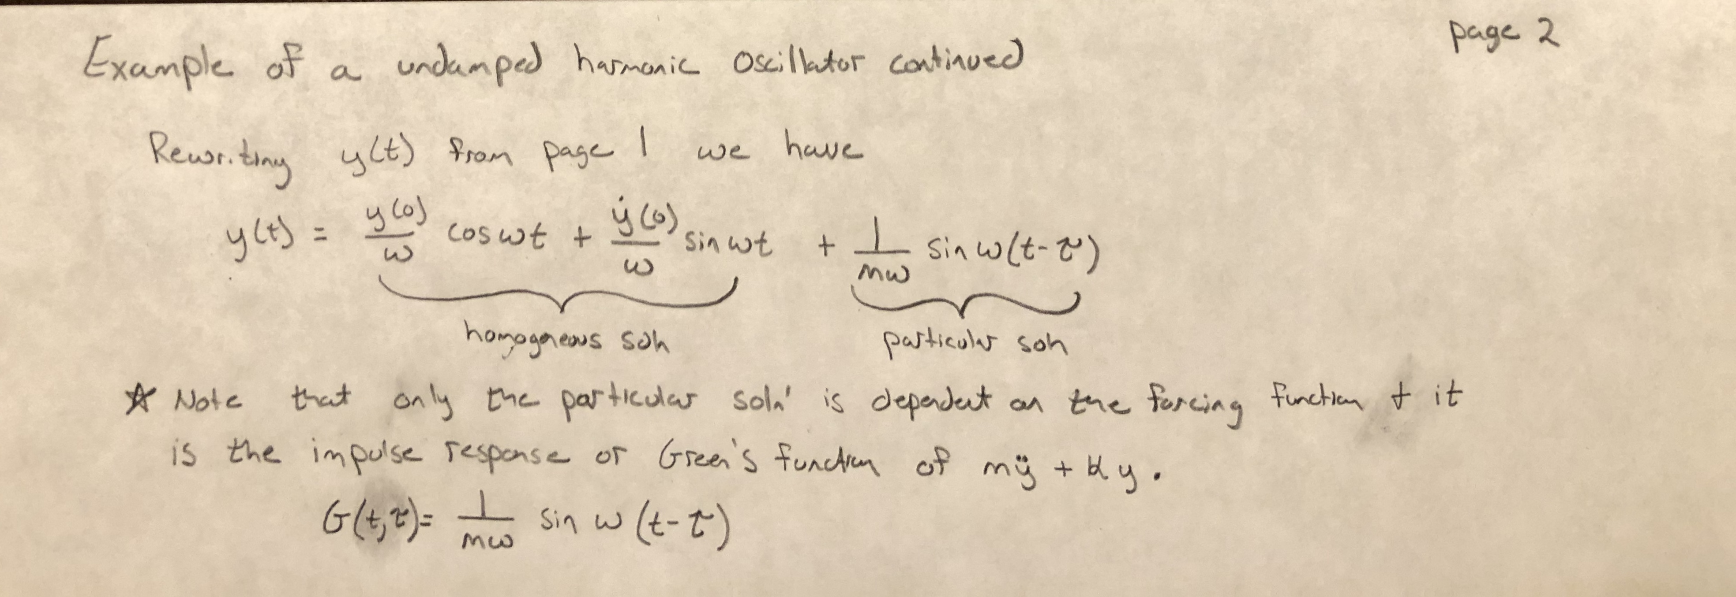

Slide 14
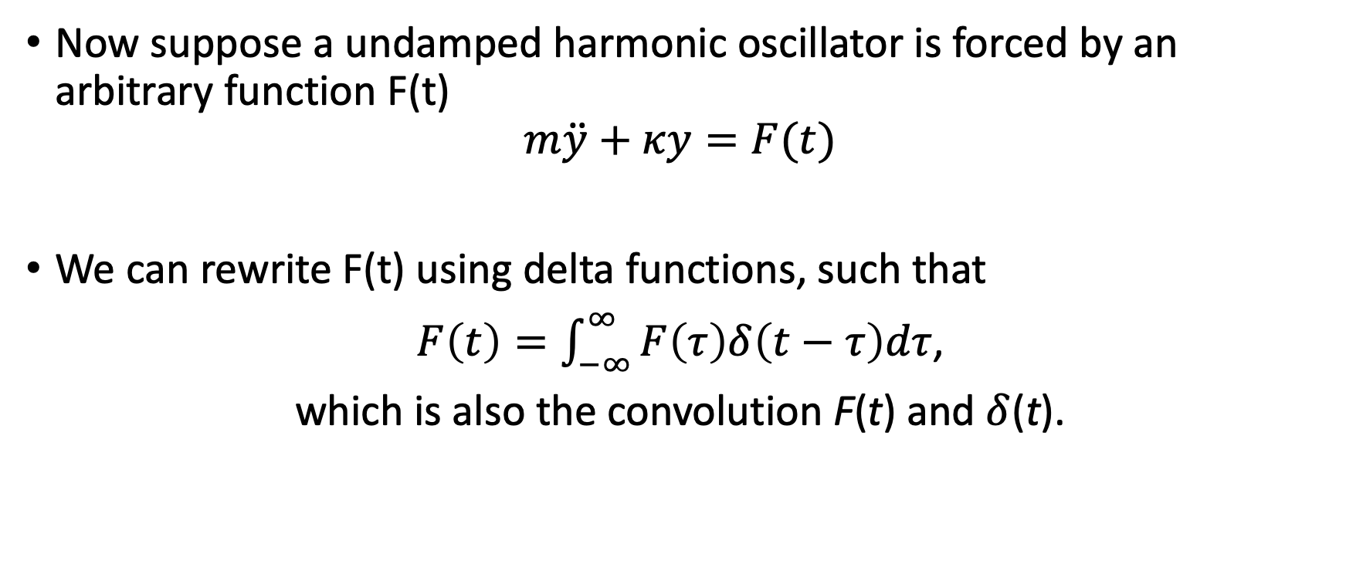
Example – Undamped Harmonic Oscillator
Now suppose a undamped harmonic oscillator is forced by an arbitrary function F(t)
$$m\ddot{y}+κy=F(t)$$
We can rewrite F(t) using delta functions, such that
$F\left(t\right)=\int_{−∞}^{∞}{F\left(τ\right)δ\left(t−τ\right)dτ}$,
which is also the convolution F(t) and $δ$(t).

Slide 15

Example of Convolution 1

Slide 16

Example of Convolution 1

Slide 17
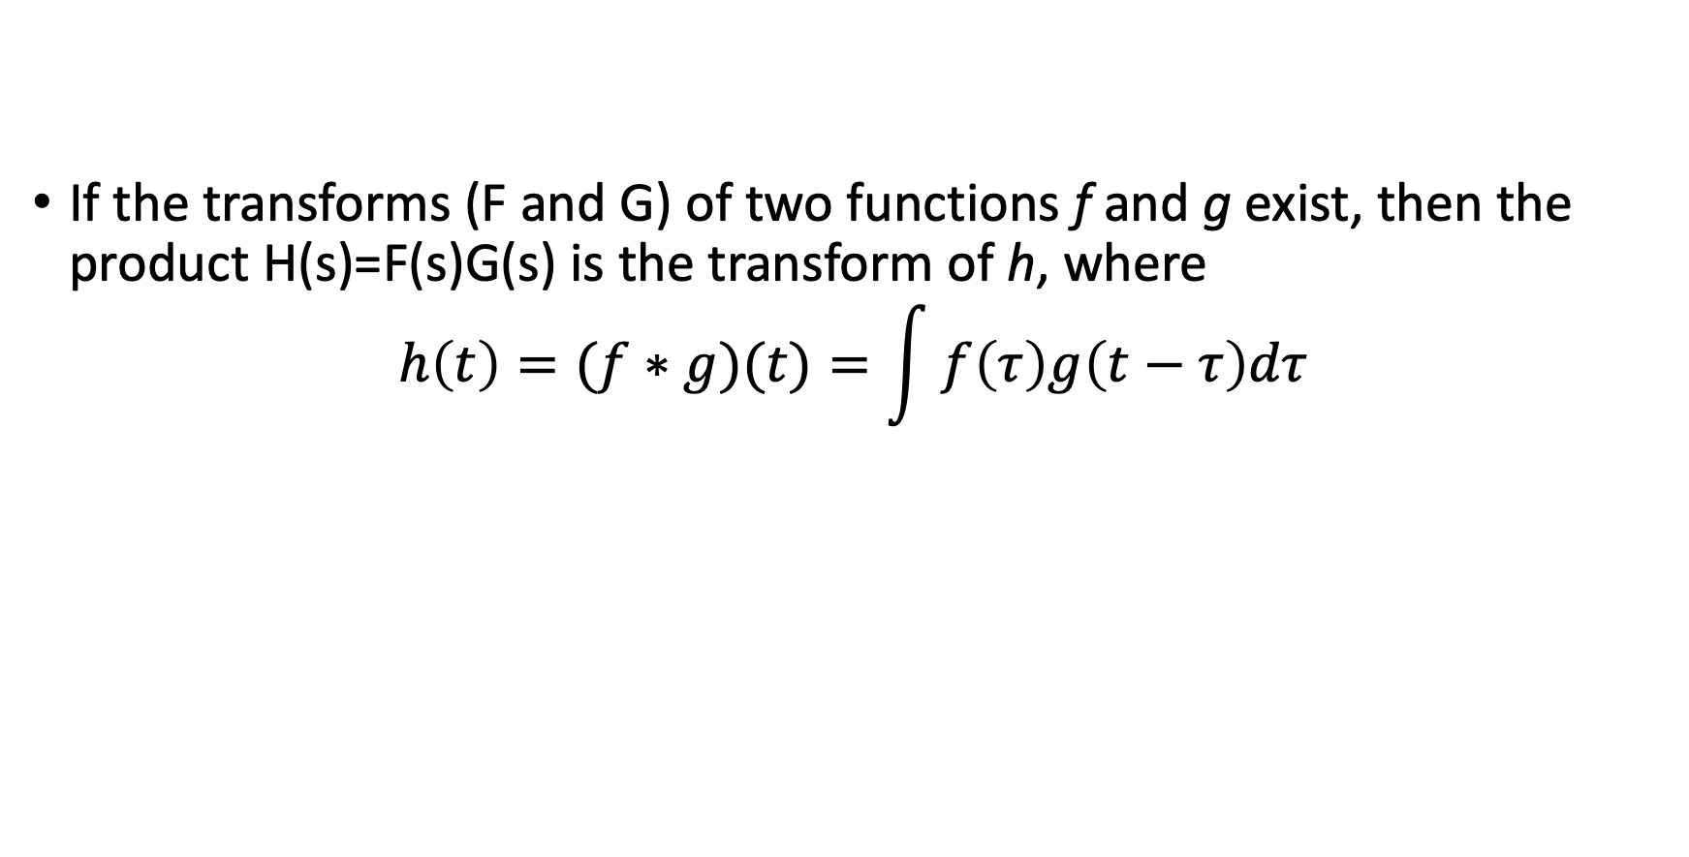
Convolution Theorem
If the transforms (F and G) of two functions f and g exist, then the product H(s)=F(s)G(s) is the transform of h, where
$$h\left(t\right)=(f∗g)(t)=\int{f\left(τ\right)g\left(t−τ\right)dτ}$$

Slide 18
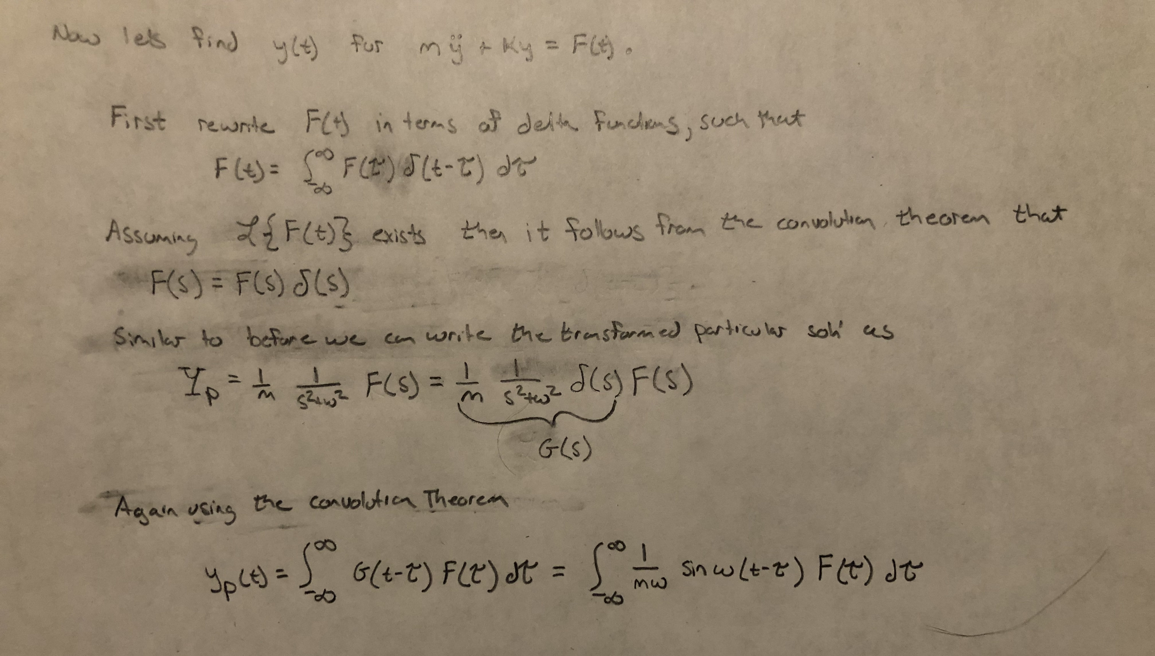

Slide 19
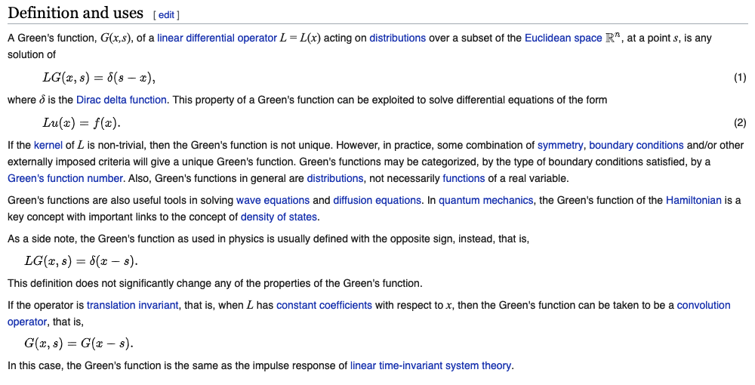
Green’s Function Summary
In mathematics, a Green's / Green function is the impulse response of an inhomogeneous differential equation defined on a domain, with specified initial conditions or boundary conditions.
In other words, assume L is a linear differential operator and G is the Green’s function, then:
This property of a Green’s function can be exploited to solve differential equations with forcing term f(x) to solve for u(x).

Slide 20
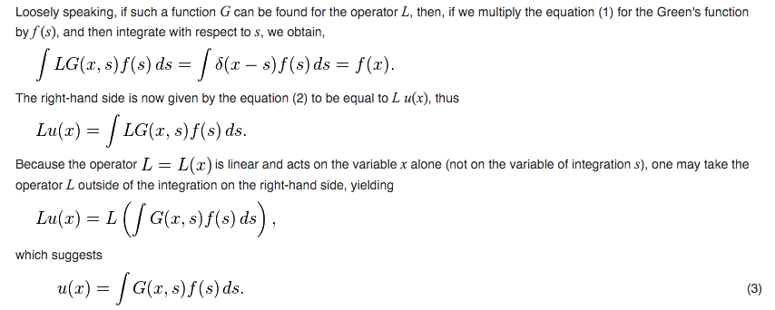
Green’s Function Summary
This means if we know the impulse response of the system, we can calculate the response to any forcing function.

Slide 21

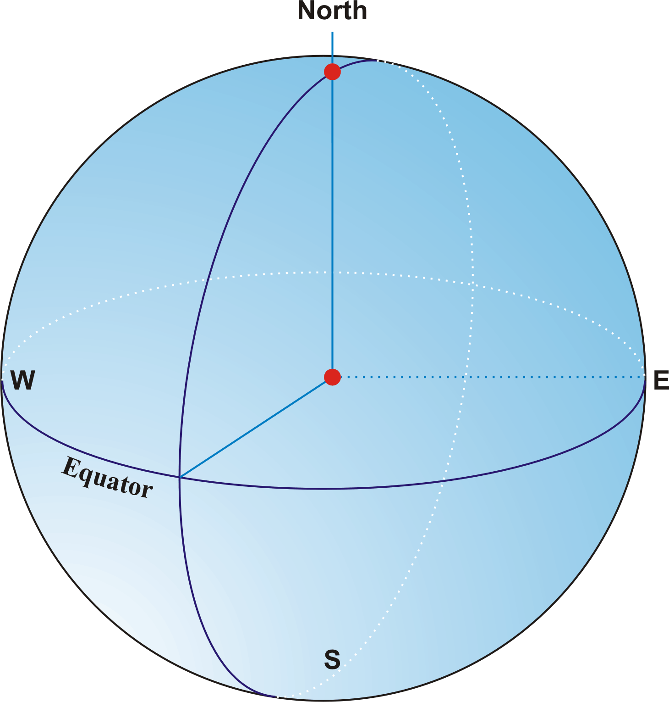
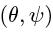
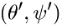
Example – Ice Loading
Consider an impulse force (ice loading) on Earth’s surface.
If Earth’s internal structure only depends on depth, the response to this impulse only depends on the angular distance between force and observation due to spherical symmetry.
The Green’s function for the vertical displacement, gravitational change, and horizontal displacement is given by so-called Love Numbers (after Augustus Love).

Slide 22
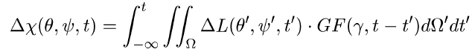
Example – Ice Loading
If we know the Love Numbers (those will be provided, not derived), we can calculate the response to any surface load (e.g. ice sheet).
Response = space-time convolution of load with the relevant Green Function:
Compared to earlier notation:
t -> x, s -> t’
ΔL is change in (ice, ocean) load;
GF is Green’s function
ΔX is response to change in load

